Slide 1
Developing and Maintaining an Open Source Project(OSP) on GitHub
Zhiling Zhang
Github @blmoistawinde

Slide 2

Table of Contents
Main Example: HarvestText (HT)
Why should we develop an OSP?
When can we develop an OSP?
How can we
Develop an OSP?
Promote an OSP?
Maintain an OSP?
Introduction of
Notes:
Finally, I’ll introduce a ongoing project for our lab, commonsense-papers, and hope we can together make it an awesome repo.

Slide 3
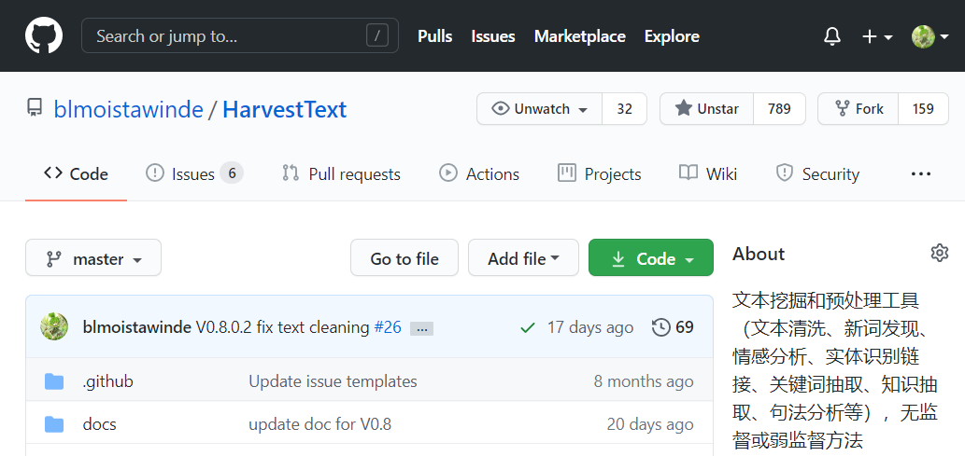
Example: HarvestText (HT)
HarvestText (HT) is an text preprocessing and keyword-oriented (aspect, entity, etc.) text mining toolkit.
Python Library, mainly for Chinese
Notes:
What can it do? ->

Slide 4
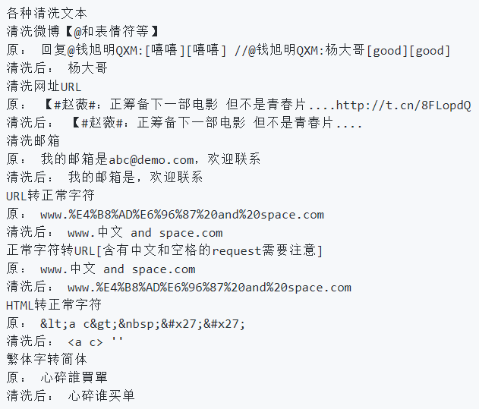
Text preprocessing
Text Cleaning
Weibo format
Emoji
URL
HTML
Traditional Chinese to Simplified Chinese
……
Notes:
It can deal with complicated text cleaning tasks

Slide 5
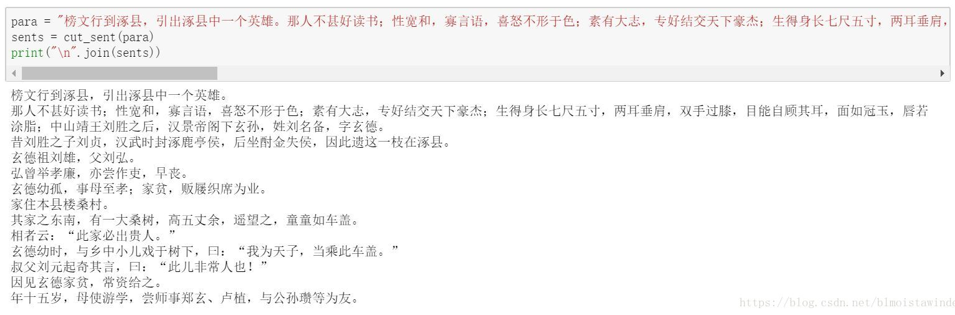
Text preprocessing
Complex Sentence Tokenization
Double quotes, Duplicating periods, etc.
Notes:
These actions make the sentence split more accurate

Slide 6
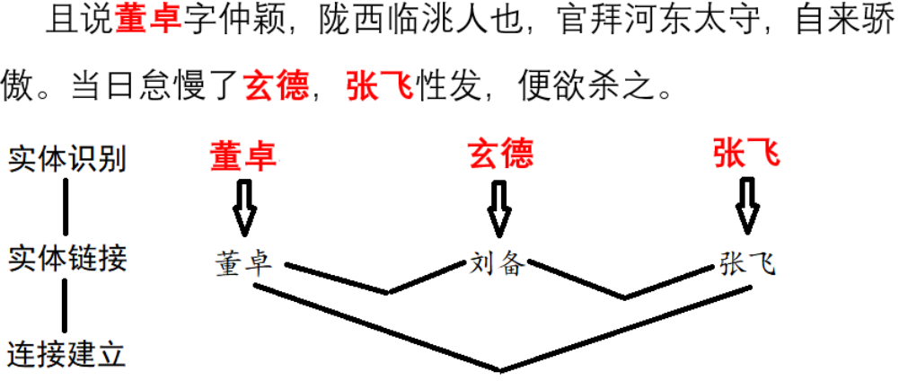
Text preprocessing
Entity-linking based word segmentation, alias merging, etc.
Notes:
First, we’ll tell the package that 玄德 and 刘备 are all names of 刘备, and 刘备 is the standard name. Then the package will link either 玄德 or 刘备 to be the entity 刘备。 Then many downstream tasks can more accurately performed on this basis, like word segmentation and social network analysis.

Slide 7
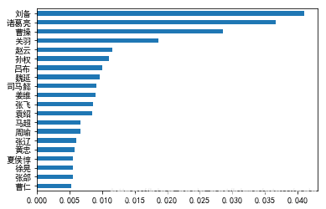
Text Mining (Social Network Analysis)
Top-20 characters according to PageRank
“An automatic list of main characters”
Notes:
This GIF shows the evolution of social network extracted from 三国演义 in chapter order.
Each node is a character, the edges are their co-occurrence, and are omitted for clarity, and the size of the nodes is the times that the character is mentioned. Note that all the textual mentions of 刘备，玄德，皇叔 will be counted into the standard node 刘备 with the help of the package.

Slide 8

Why should we develop an OSP?
An interesting way to practice useful skills
Version Controlling (Git)
Open Source Community (GitHub)
Software Engineering
Topic of your interest (e.g. text preprocessing and mining for HT)
Easy to share to others and get feedbacks
Notes:
You may learn git skills for version controlling.
You may learn how to contribute to the open source communities like GitHub.
And you’ll also practice your software engineering skills by properly organize a project so that it is both easy for users to use and for developers to understand.
And you can further enhance your understanding on topic of your interest by establishing a project about it.
The interesting point is that you can easily share your work to others, and get feedbacks from them, either positive ones like stars, or possibly negative ones like issues. Those feedbacks can help us further improve our work.

Slide 9
Why should we develop an OSP?
Project: gain attention and popularity
Paper official/reproduction code helps future research (and citations)
Deployed project can get many (free) contributors and users
Get popular, improved by users feedbacks/contributions and even become standard
Linux, Android, Python, TensorFlow, PyTorch, etc.
Personal: gain reputation
A spotlight on CV/resume
Legends: Linus Torvalds for Linux, Guido van Rossum for Python
Notes:
There are still more benefits:
From the project’s perspective
For us researchers, if you open-source your code for paper exps, it can enable reproduction of your work in future research, and as a result, lead to citations.
And for other deployed projects, the easy access by open-sourcing, make it easier to become popular, and user feedbacks and contributors can make it better, and even make it a standard.
That’s how famous projects like linux, android get their current positions.
It’s interesting that companies like Google can actually make “profits” from these “free” open-source software by occupying the market.
And they have become so popular that if they cease to open source anymore, you might even be 卡脖子.
Although we are not big companies, there are still benefits from our personal perspective.
You may gain reputation from your project. The project can be a spotlight on your CV.
And if you are strong enough, you may even become legendary figures like Linus, Guido. Then it’s not that you are looking for a job, but jobs are chasing you.

Slide 10
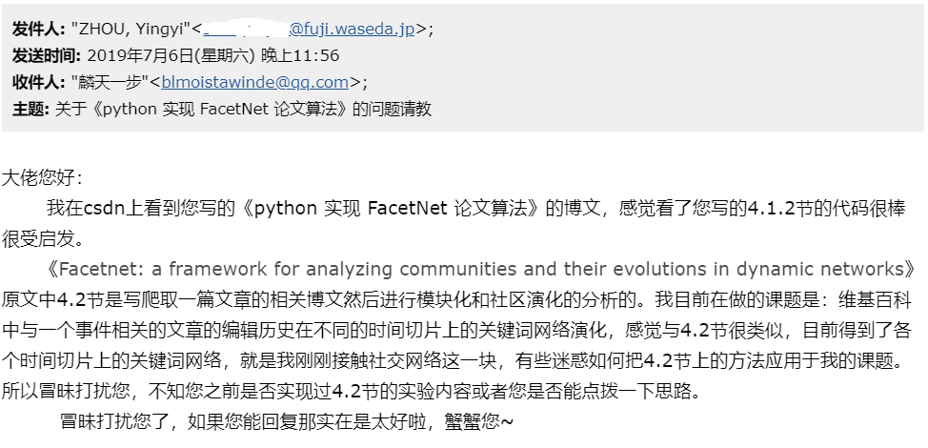
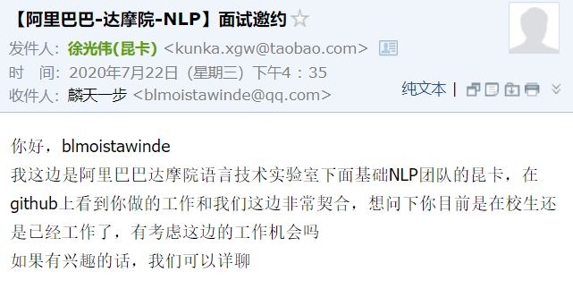
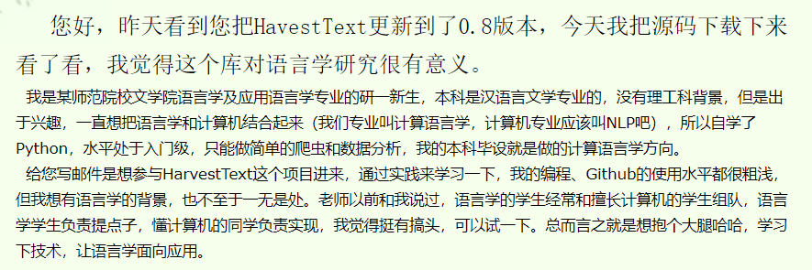
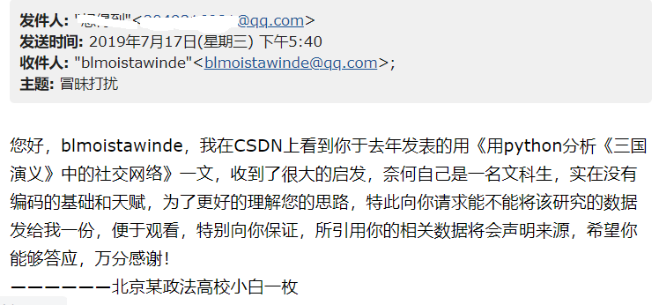
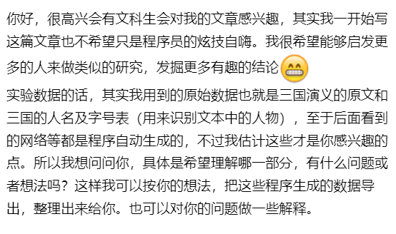
Why should we develop an OSP?
A fulfilling experience
Help all kinds of people and get their words
Notes:
Finally, it’s very fulfilling to know that your work can actually help all kinds of people, especially when you get direct words from them. Let me share some with you.
There are humanity students interested in this project.
A Chinese girl studying at 早稻田大学, seeking for academic collaboration. Although it’s not successful for some reasons, I still think it’s a nice experience.
There are also users who want to contribute to the project.
And I even got an interview invitation, that’s very exciting.

Slide 11
When can we develop an OSP?
“If you’ve never open sourced a project before, you might be nervous about what people will say, or whether anyone will notice at all. If this sounds like you, you’re not alone!”
——Open Source Guides
Many GitHub users have no own OSP (excluding forks)
When/Under what condition can we make sure that we can make a good OSP?
Notes:
I think most of us would agree that developing an OSP has some benefits for us, even without my above words.
But I think the most difficult part is to actually do it. Because we may not be very confident.
Actually, as this quote says, XXX. these thoughts are quite prevalent, many users including me had this.
And the truth is that many XXX
So The question is When xxx

Slide 12
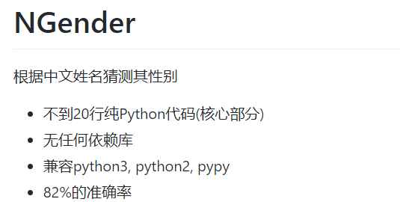
Example: ngender
A good OSP doesn’t have to be complicated
Simple and effective gender prediction toolkit
Based on Naïve Bayes
Notes:
First, I’d like to say that a good OSP xxx

Slide 13
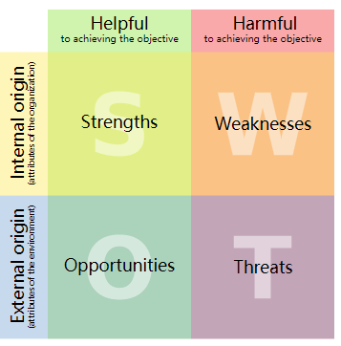
SWOT model for decision making
Internal (Strength, Weakness): outstanding knowledge, ideas, skills
For HT: my NLP experiences
Reusing much code for course project
External (Opportunities, Threats): low competition from similar projects
For HT: (maybe) no simple solution for tasks that HT does, at the time of creation, though there are needs for them. (e.g. my project)
Notes:
Next, decision making techniques, like the SWOT model can help us.
How did I decide to create HarvestText?
From the Internal dimension,
I have already created these wheels for a course project, so I can easily reuse these code. I just need some small modifications to make it more user-friendly.

Slide 14
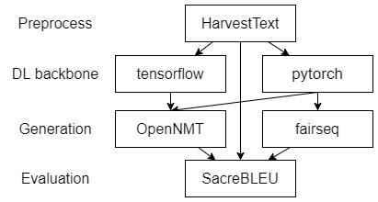
Quiz: identify competitors
Which of the following python libraries compete with each other?
HarvestText, tensorflow, pytorch, fairseq, openNMT, sacreBLEU
Notes:
This actually tests your background knowledge on these famous NLP libraries.
Libraries used at the same stage of the pipeline are competitors. HarvestText is a preprocessing tool, so it doesn’t compete with other famous projects.

Slide 15
Develop an OSP (Git)
Git 101(basics)
$ git clone [url]: Clone (download) a repository that already exists on GitHub, including all of the files, branches, and commits
$ git log: Lists version history for the current branch
$ git pull: Updates your current local working branch with all new commits from the corresponding remote branch on GitHub
$ git push: Uploads all local branch commits to GitHub
$ git add [file] : Snapshots the file in preparation for versioning
$ git commit -m “[descriptive message] ” : Records file snapshots permanently in version history
More:
https://training.github.com/downloads/github-git-cheat-sheet/
Notes:
Now that we’ve decided to create an OSP, it’s time to talk about the development.
The basics for development on GitHub is no doubt Git.
These are basic cmds in git, so I just list them here and won’t explain them.

Slide 16
Develop an OSP (Git Quiz)
Quiz: Order these cmds, if you want to update a remote repo
Edit files locally
$ git pull: Updates your current local working branch with all new commits from the corresponding remote branch on GitHub
$ git push: Uploads all local branch commits to GitHub
$ git add [file] : Snapshots the file in preparation for versioning
$ git commit -m “[descriptive message] ” : Records file snapshots permanently in version history
2, 1, 4, 5, 3

Slide 17
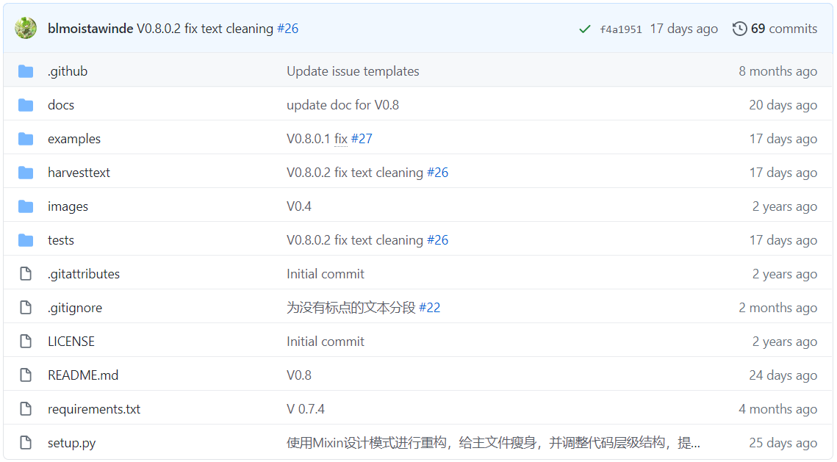
Develop an OSP (Structure)
Recommended
Recommended
Necessary
Recommended
Recommended
Recommended
Necessary
Recommended
Necessary

Slide 18
Import structure
User API
from harvesttext import HarvestText
Inner Structure
In harvestext/harvestext.py: (define the class)
README.md
setup.py
harvesttext/
__init__.py
harvesttext.py
word_discover.py
algorithms/
__init__.py
keyword.py
class HarvestText(…):
[*] In harvestext/__init__.py: (import class to root)
from .harvesttext import HarvestText
Import harvesttext is actually import harvestext/__init__.py
Without [*], the API needs to be:
from harvesttext.harvesttext import HarvestText
In harvestext/algorithms/keyword.py
def textrank(…):
In harvestext/word_discover.py
from .algorithms.keyword import textrank
harvestext/algorithms/__init__.py is empty, but necessary
Notes:
I want to especially mention the import structure of a python library, because it’s very easy to get confused.
First, let’s pay attention to the __init__.py. We typically don’t need this for our local research projects. However, it is compulsory for a package because it is marks the root of a directory. Without it, you’ll get errors when loading the package.
This is the user API. How can we support this in our package?
We first define the class in this file. We also need to import it at __init__.py
And you need to use a “dot” to specify that you’re import from the same level of this file, which is not required for local projects.
This import is very important, because without it, the user API will more tedious.
When user load sth from the package name, he is actually importing things in __init__.py, if you don’t load things to this root file, you need to specify the file to load from.
Another example is to import a utility function from inside the package. We also use the dot operator to specify the file to load from.

Slide 19
Import structure(Quiz)
README.md
setup.py
ht/
__init__.py
ht.py
resources.py
How to import all things from ht/resources.py at ht/__init__.py ?
from .resources import *
How can user import get_stopwords() from ht/resources.py
(with and without the above line)?
from ht import get_stopwords
from ht.resources import get_stopwords
Notes:
With the above line, all the functions have already been loaded into the root of the package, so user just need to load from ht
Otherwise, the user have to specify the file to load from.

Slide 20
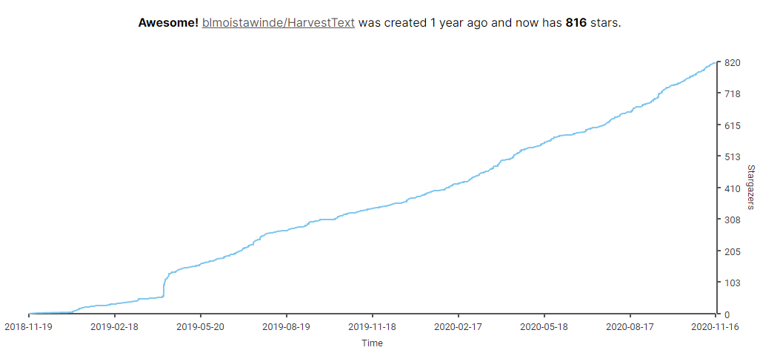
Promote an OSP
Notes:
This figure shows that the stars, or users grow with time.
After developing the project, we need to promote it, to get users.
This part is no simpler than developing a project, and I can’t say I’m an expert in it.
But some practice still might be useful, and I’ll share them with you.

Slide 21
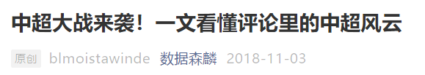
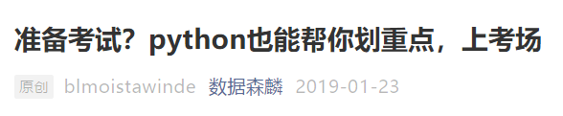
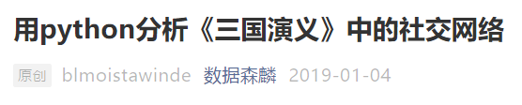
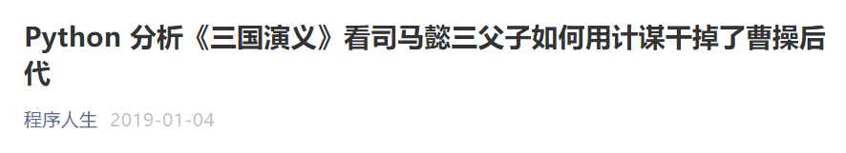

Promote an OSP (Actively Posting)
Star: 1 -> below 50
Notes:
First, at the cold start stage, I wrote several articles about the use case of the repo and submitted them to a wechat public account. Its daily reader is about 1000.
The owner again submitted to a more famous account.
The best one got over 10 thousand readers, and I was pretty excited about the result.
But when I see the stars for my repo, I become a little bit frustrated, because I only gain below 50 stars after all.
(A small question: Do you know why there is one star at the beginning? 233)

Slide 22
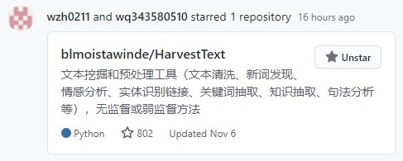
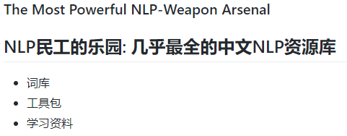

Promote an OSP (Social Dissemination)
GitHub “Feed” :
User blog:
Star: below 50 -> about 200 (in a short period)
Notes:
The turning point happens when a famous repo collected my project into its collection
The result is quite impressive as the stars come from 50 to about 200 in a short period.
Later on, there are also other social disseminations, like the feed and other user’s blog about it, attracting even more users.

Slide 23
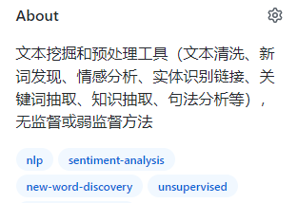
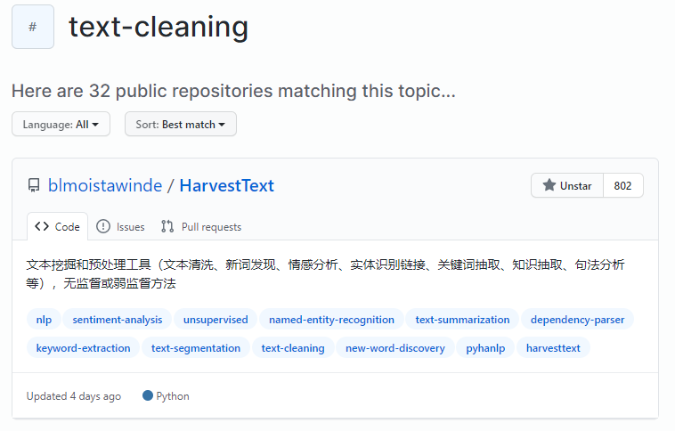

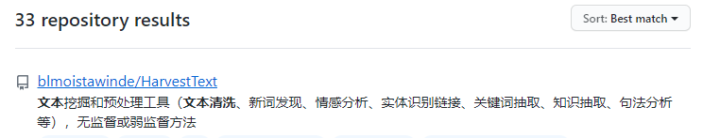
Promote an OSP (SEO)
Notes:
Finally, I also applied some search engine optimization (SEO) techniques.
I included some key features in the repo’s introduction, so that it can be easily retrieved by search engine.
I also add tags to the repo, and users can access my repo from the tag.
Repos under the same tag are sorted by stars, and as you can see, HT is at the first place under the tag “text-cleaning”, so more users will find the repo with the tag.

Slide 24
Maintain an OSP (issues and PRs)
Issues
Bug report, Feature/enhancement/resource request
Causal discussions like BBS (not recommended)
Should consider priority (importance/urgency) and deal with them
Pull Requests (PR)
Other users aren’t authorized to directly modify your repo
They “pull” your repo’s copy and modify on it
After modifications, they request to merge them into your repo
You review the changes and decide whether to merge/modify/reject
Notes:
For the maintaining part, there are so many points to talk about, and I just briefly mention the basic components like issues and PRs

Slide 25
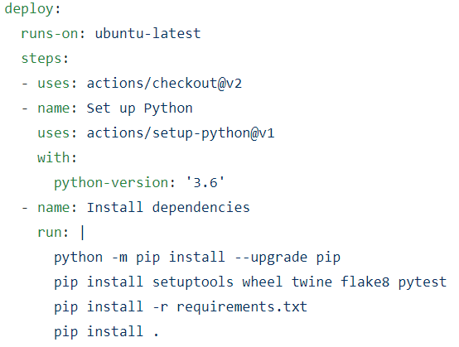
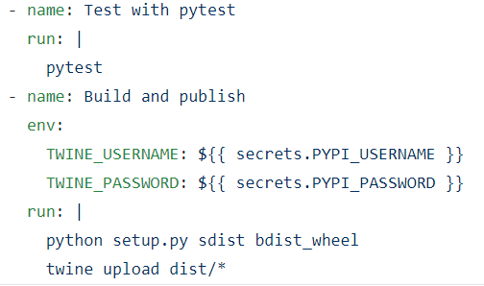
Maintain an OSP (CI/CD)
Continuous Delivery(CD) with GitHub Action
Define workflow with yml
After I commit some update code:
Automatic testing and publishing
Publish will be prevented if any test case fails
Notes:
I also want to introduce an excellent feature of GitHub.
That is, you can achieve CI/CD with GitHub Action.
CI/CD is a popular term in software engineering. It’s a sophisticated term and I won’t give you a tedious explanation, but will give you an example.
This example will show its usefulness for my project.
It define a workflow with yml.
You don’t have to read all of them to get an understanding, you just need to scan the names, so it is very clear.
With these code, after I xxx. GitHub will help me automatically establish an environment for xxx
The automatic testing makes the release more reliable, because if we rely on human to test, some test cases may be omitted due to carelessness or laziness, then bugs will be in the released version, which may irritate the users.

Slide 26
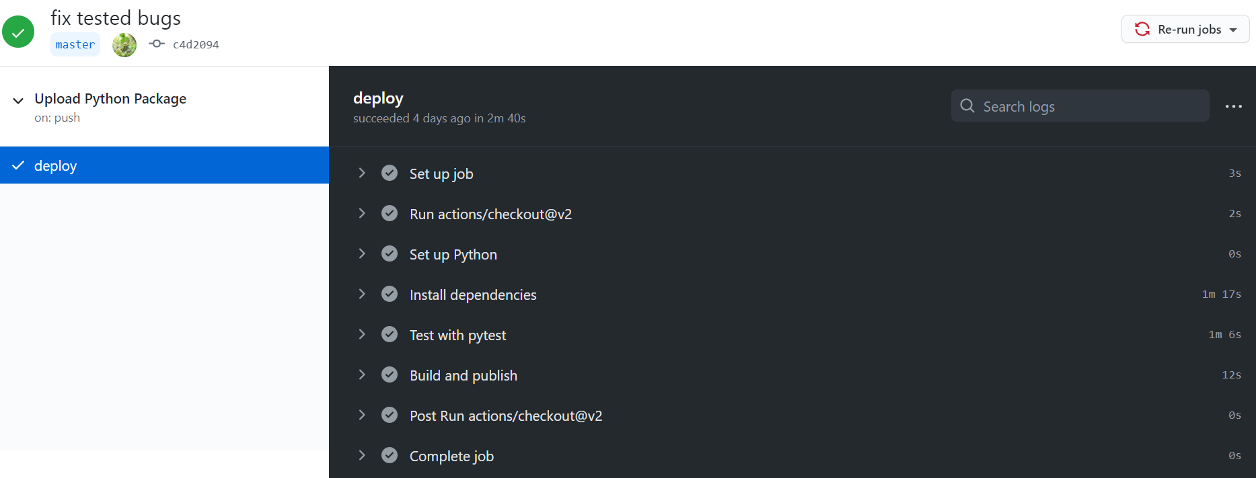
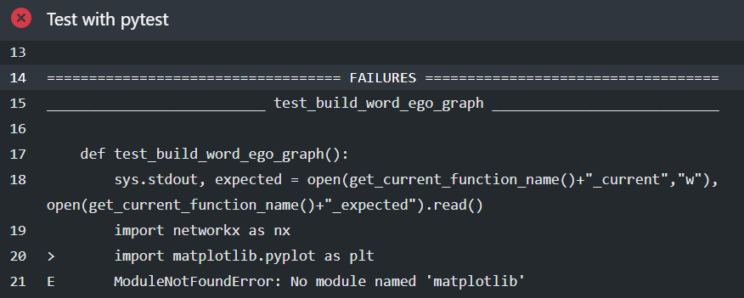
Maintain an OSP (CI/CD)
Continuous Delivery(CD) with GitHub Action
Quiz:
Which part of my repo may have problem?
“matplotlib” not in requirement.txt

Slide 27
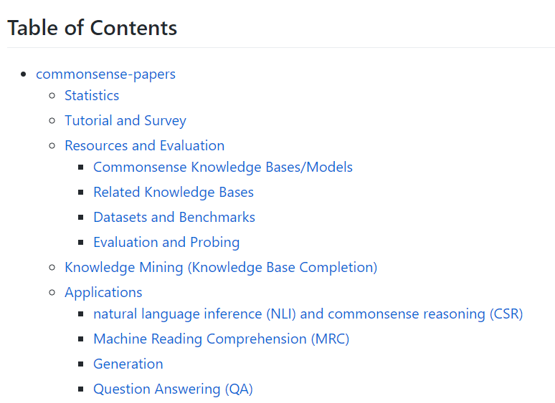
Call For Contributors!
Strength:
Many adapters are working on this
Weakness:
(Relatively) low reputation (by now)
But will have more
Opportunity:
No similar repo so far
Threat:
Other similar repo
we can occupy the first
Notes:
Finally, I want to introduce an opportunity that we may establish an awesome project together.
That is the commonsense-papers project.
Why can we do this? Here’s my SWOT analysis.
Since many of us are working on this, we should have a better understanding on this topic than many other research teams.
We do have weakness that our lab is “relatively” not that famous by now, compared to well-known figures like Yejin Choi, but I do believe that we’ll have better reputation with our future works, as well as more exposures, including the creation of this repo.

Slide 28
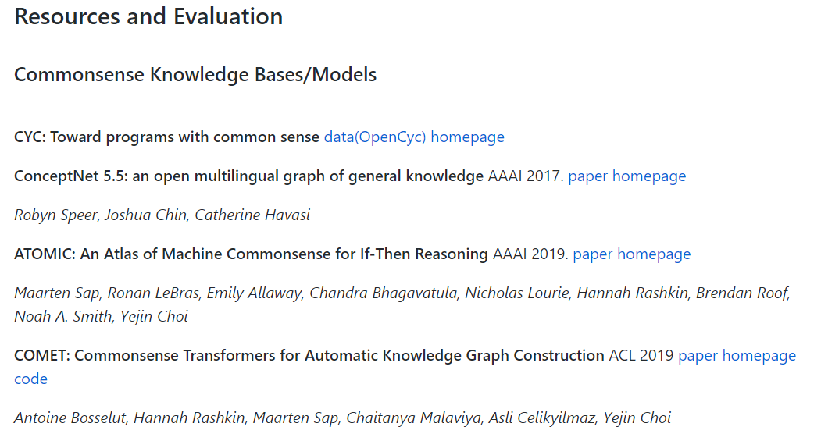
Notes:
This is the appearance of the repo, contains the taxonomy, paper title, authors, venues and resource links.
Currently I mainly collect papers from my readings, Roy’s readings and some papers that we discussed in previous seminars.

Slide 29
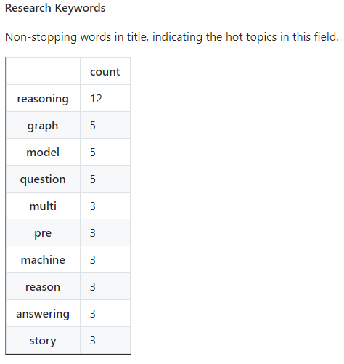
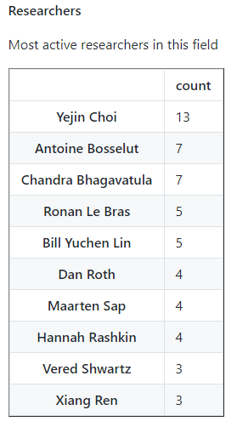
Commonsense-papers (current stats)
Notes:
I’ve made some data analysis about the papers in the repo, and it gives us some interesting insights.
Currently there are 52 papers in this repo.
There is a name that Kenny should be familiar with. I see many excellent jobs from Bill recently.

Slide 30
Commonsense-papers (Roadmap)
Goal of the repository:
By
selecting the most representative and innovative papers in the research field of commonsense knowledge
providing taxonomy/classification as well as statistics of these papers
To
give a quick overview of the field
help focused reading on certain topic
Since I can’t give a complete paper-list by myself, your contributions are largely appreciated!

Slide 31
Conclusion
Why and when to develop an OSP
How to develop/promote/maintain an OSP
Can learn all kinds of skills
Decision making (SWOT)
Software engineering (Git, Project structure, CI/CD, …)
Marketing
Fulfilling experience with collaboration and contribution
Let’s make great again(MAGA)!

Slide 32

Follow me on Github!
moist
bl a de
wind
blade 坚强
moist 润泽
wind 自由
Notes:
There are 3 metaphors or 意象 in my nickname for my life pursuit. Like a motto (座右铭)

